Slide 1
Sentiment Analysis of Musical Instruments Reviews
By Krishan Goyal

Slide 2
Content
Introduction
Data Understanding
Data Preparation
Modelling
Evaluation
Conclusion and Future work

Slide 3
Introduction
This presentation presents an approach for sentiment analysis to mine sentiments of user reviews by classifying them as per their corresponding ratings and reviews.
The goal is to predict an overall sentiment, either positive or negative, of customer reviews from around 10,000 musical instruments reviews left by customers collected from websites from were these customers bought the musical instruments.
We will be applying CRISP-DM to analyze our dataset and make sense out of the data provided.

Slide 4
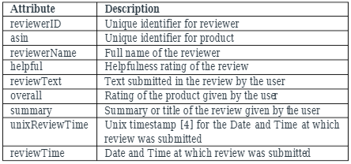
Data Understanding
The dataset contains 10,262 rows and 9 columns containing reviews of different customers about musical instruments they bought online
Description of all columns are

Slide 5
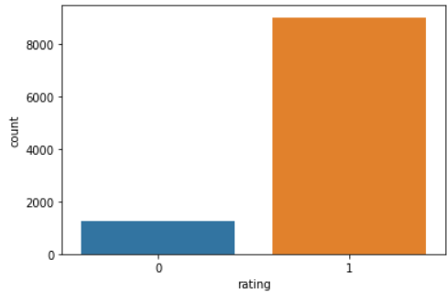
Data Preparation
Removing of Useless features such as reviewer ID, asin, reviewer Name, helpful, unix Review Time, review Time.
Removing duplicates and Replacing missing values.
Classifying ratings as GOOD (1) for 5,4 rating and BAD (0) for 3,2,1 rating
Removing stop words, Removing punctuations from text columns.
Tokenization, Lemmatization

Slide 6
Modelling
SUPERVISED LEARNING
Splitting the data into 80% for training and 20% for testing And
Using Machine learning Algorithms Like:
Naïve Bayes
Logistic Regression
Random Forests
Support Vector Machine
With Two Different Approaches for analyzing text based data fields
Bag of-Words
The methodology is extremely simple, basic, flexible and adaptable, and can be utilized in a heap of ways for extracting features from documents.
and
TF-IDF
TF: Term Frequency , which quantifies how regularly a term happens in a report.
IDF: Inverse Document Frequency, which quantifies how significant a term is.

Slide 7
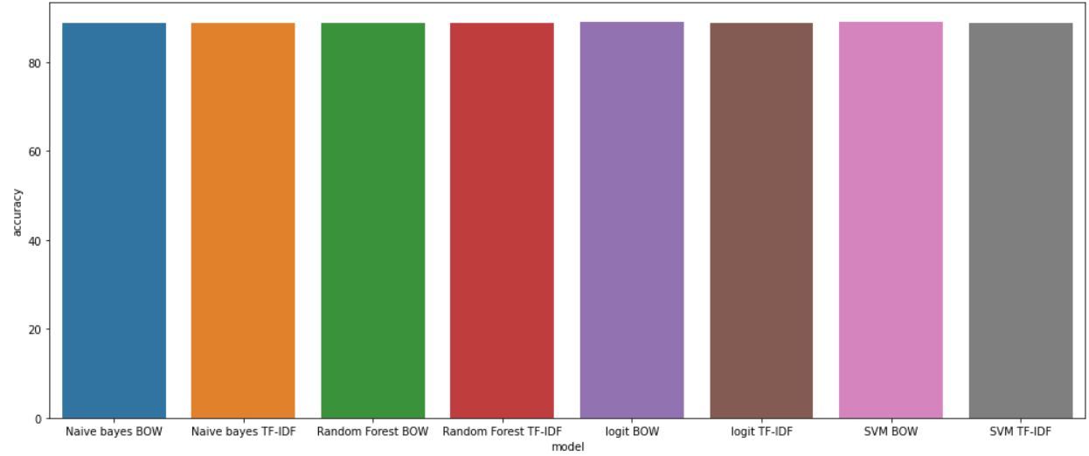
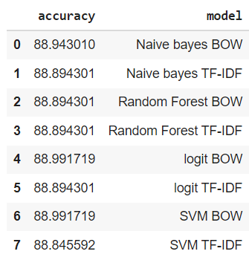
Evaluation
All the machine learning algorithms we implemented on our dataset performed well and was able to give us almost similar results.

Slide 8
Conclusion and Future work
This was a simple supervised machine learning approach for sentiment analysis, were we are able to predict good results from the data provided.
Our future work for more advanced analysis will involve usage of more advanced methods such as
SMOTE UPSAMPLING METHOD for data balance
And implementing Natural Language Processing Algorithms in Deep Learning since they perform relatively better for text based datasets.
We can also use Long-Short Term Memory (LSTM) and Bi-Directional LSTMs for further enhancements.

